Slide 1

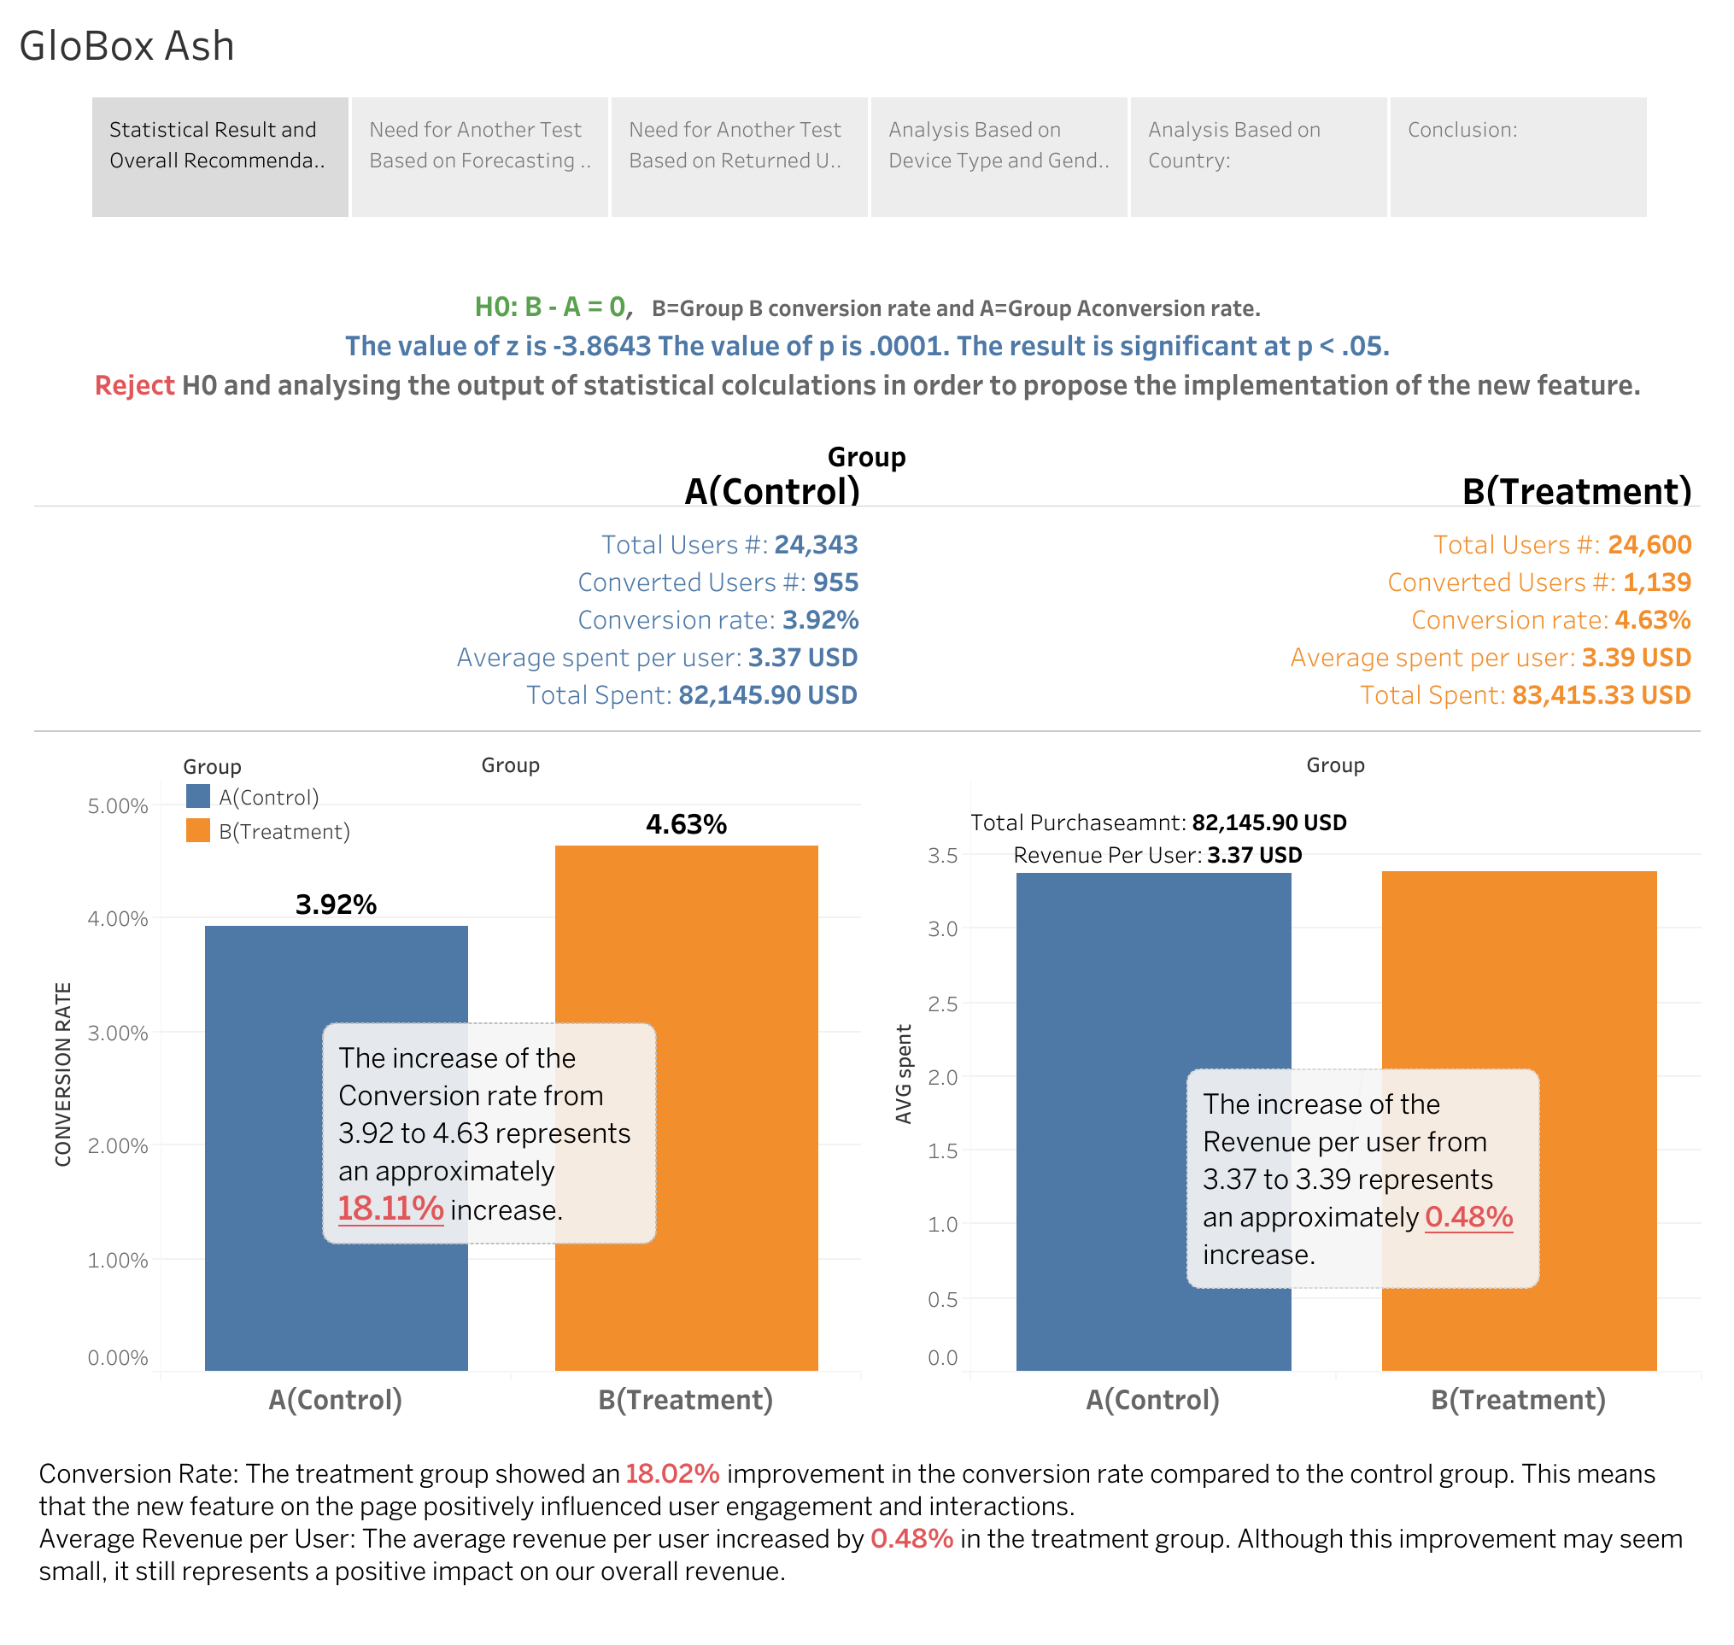
1. Statistical Result and Overall Recommendation:
Conducted an A/B test on two groups: Group A (Control) and Group B (Treatment) with a new feature.
Statistical analysis:
p-value = 0.001, indicating a significant difference between the groups.
Results:
Group B showed an 18.02% improvement in conversion rate and a 0.48% increase in average revenue per user.
Recommendation:
Launch the experiment considering the low cost, positive improvements, and statistical significance.

Slide 2
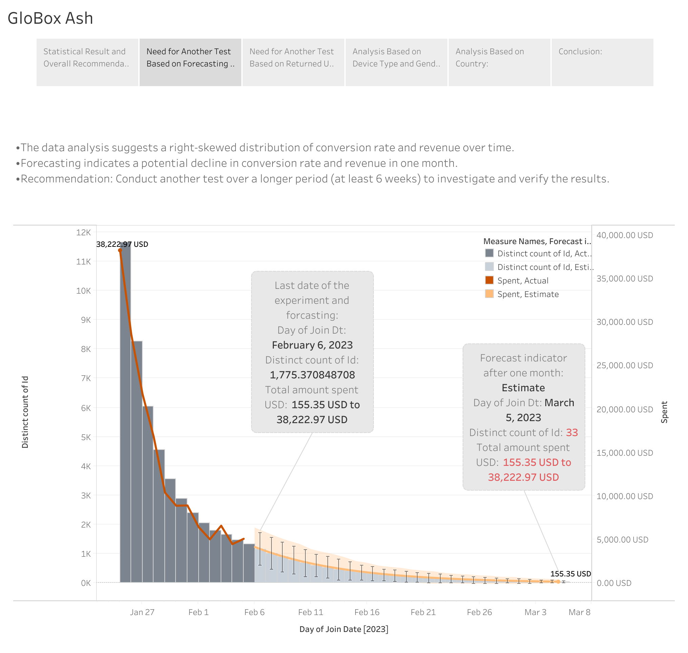
Need for Another Test Based on Forecasting Data:
•The data analysis suggests a right-skewed distribution of conversion rate and revenue over time.
•Forecasting indicates a potential decline in conversion rate and revenue in one month.
•Recommendation:
Conduct another test over a longer period (at least 6 weeks) to investigate and verify the results.

Slide 3
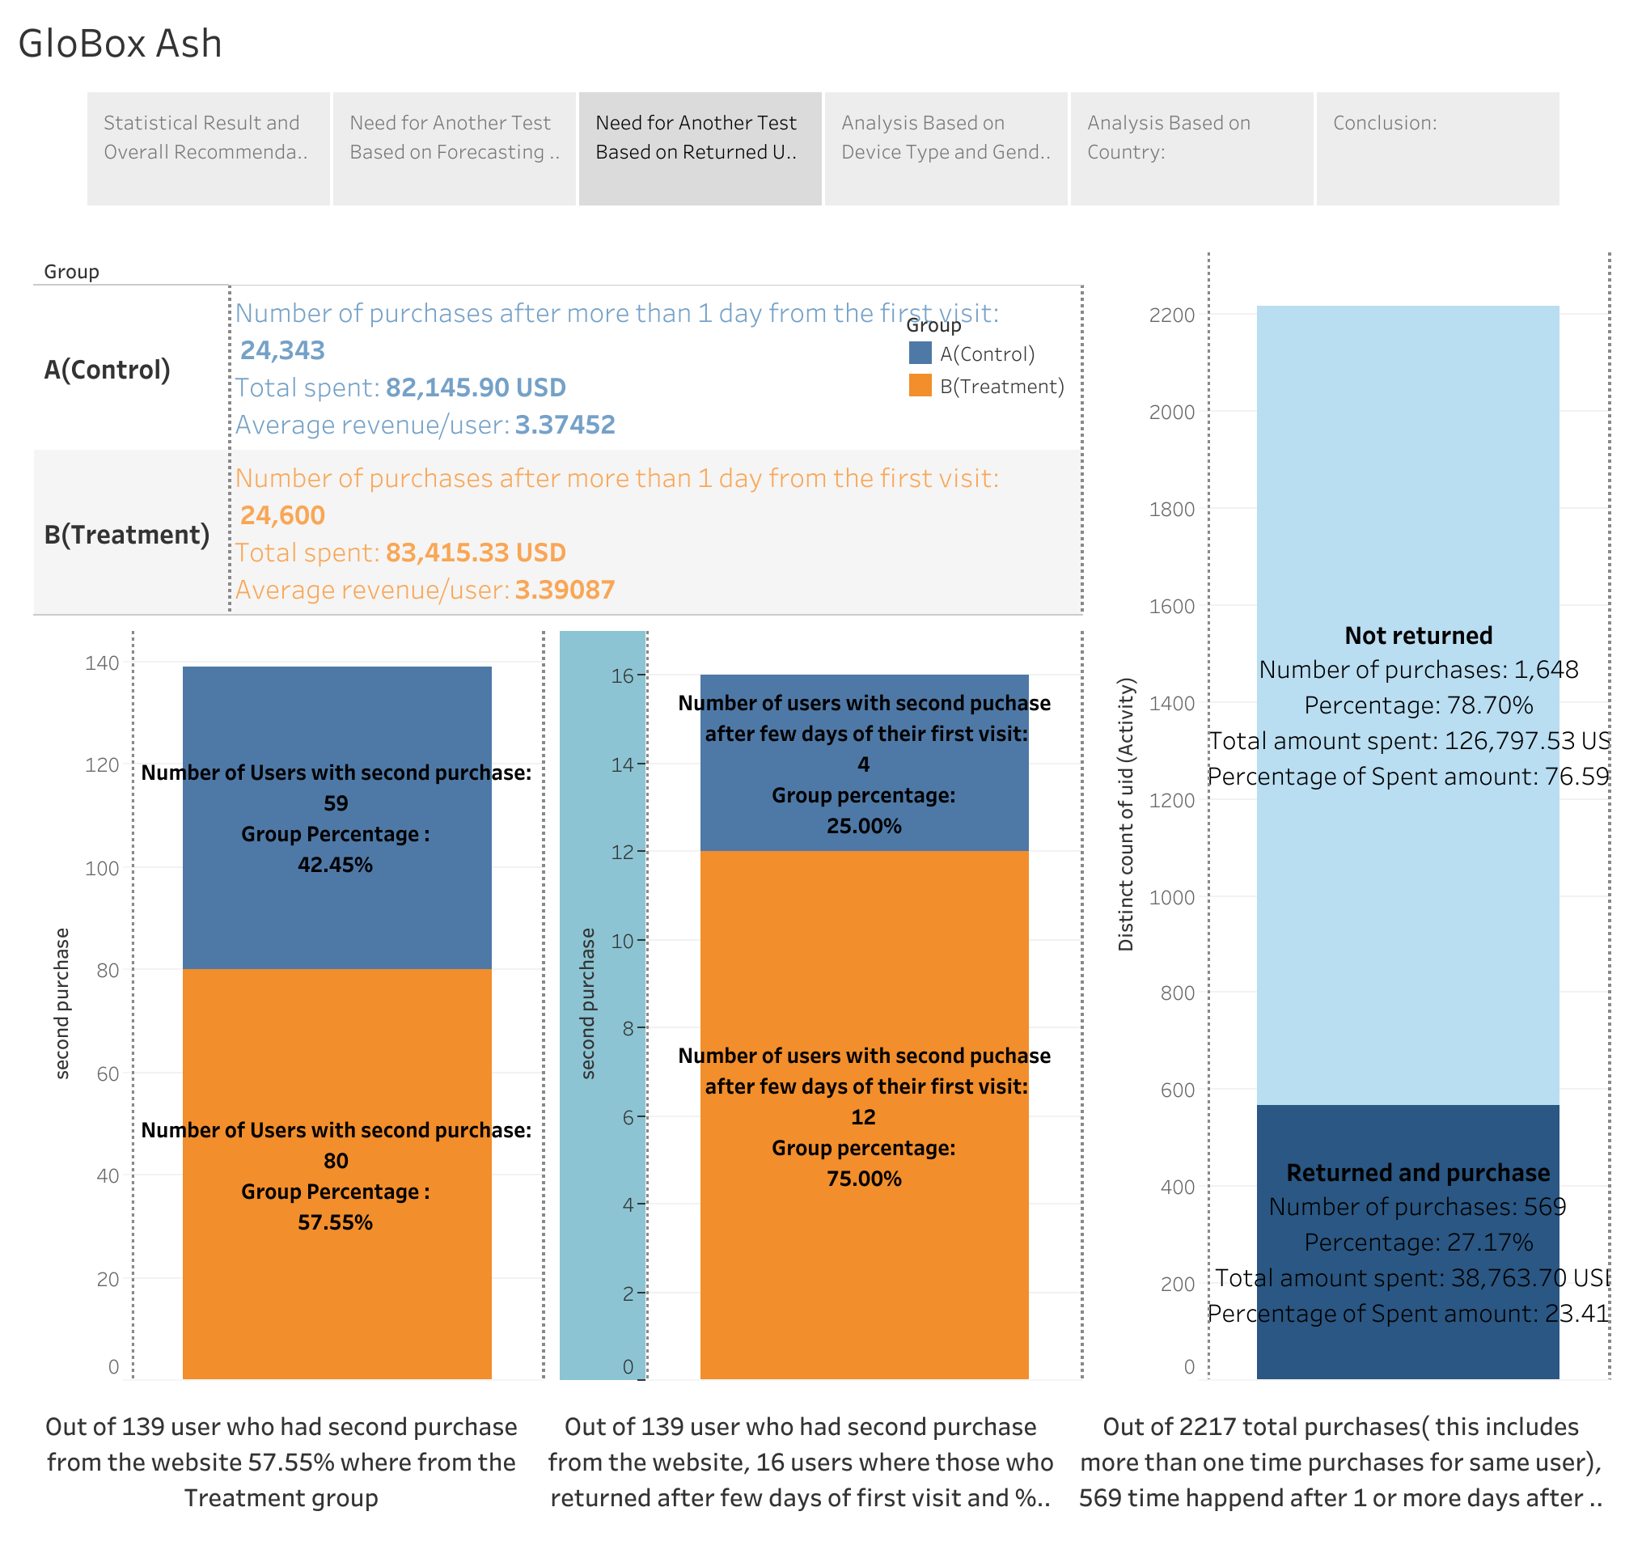
3. Need for Another Test Based on Returned Users and Second-Time Buyers:
• A significant portion of converted users (27.17%) returned to make purchases after a few days.
• Total revenue generated by these returning users accounted for 23.41%.
• Short test duration may have missed potential conversion and purchase outcomes.
• Recommendation:
Extend the test duration to capture the behavior of returning users and their impact on conversion and revenue.

Slide 4
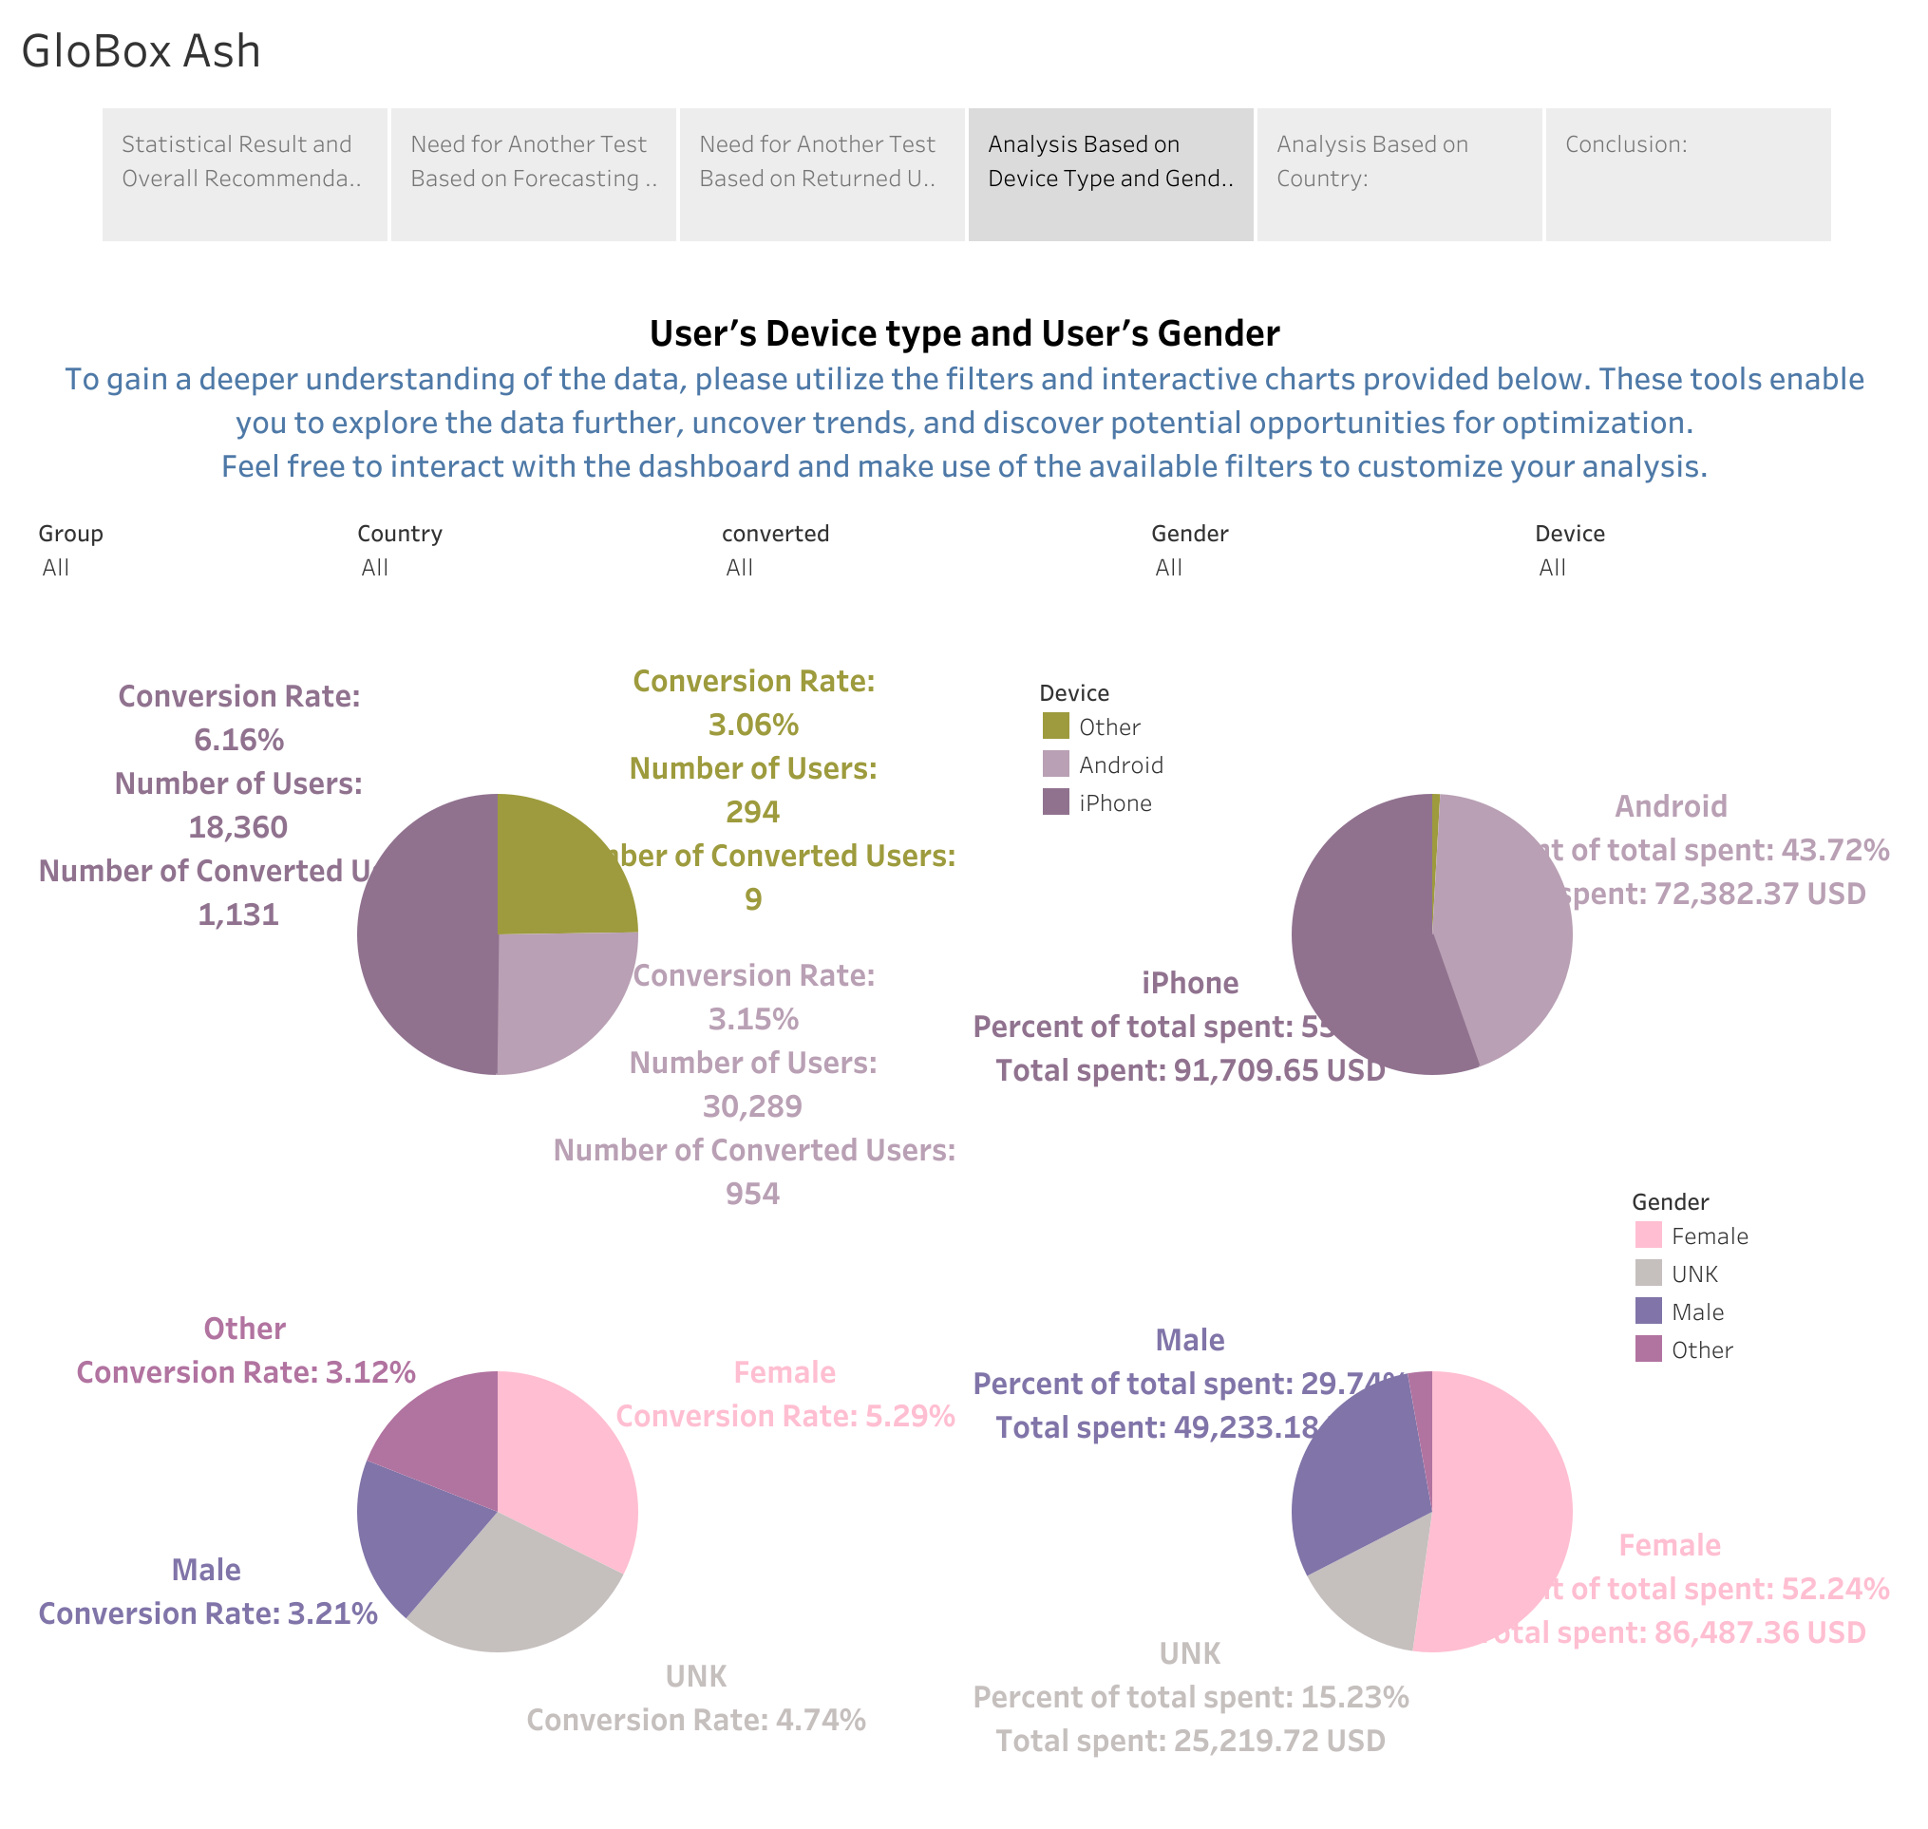
4. Analysis Based on Device Type and Gender:
• Greater conversion rate improvements were observed among iOS and other devices.
• Only Android users showed an increase in average spending.
• Suggestion:
Investigate design differences between Android and other devices to optimize the user experience across all platforms.

Slide 5
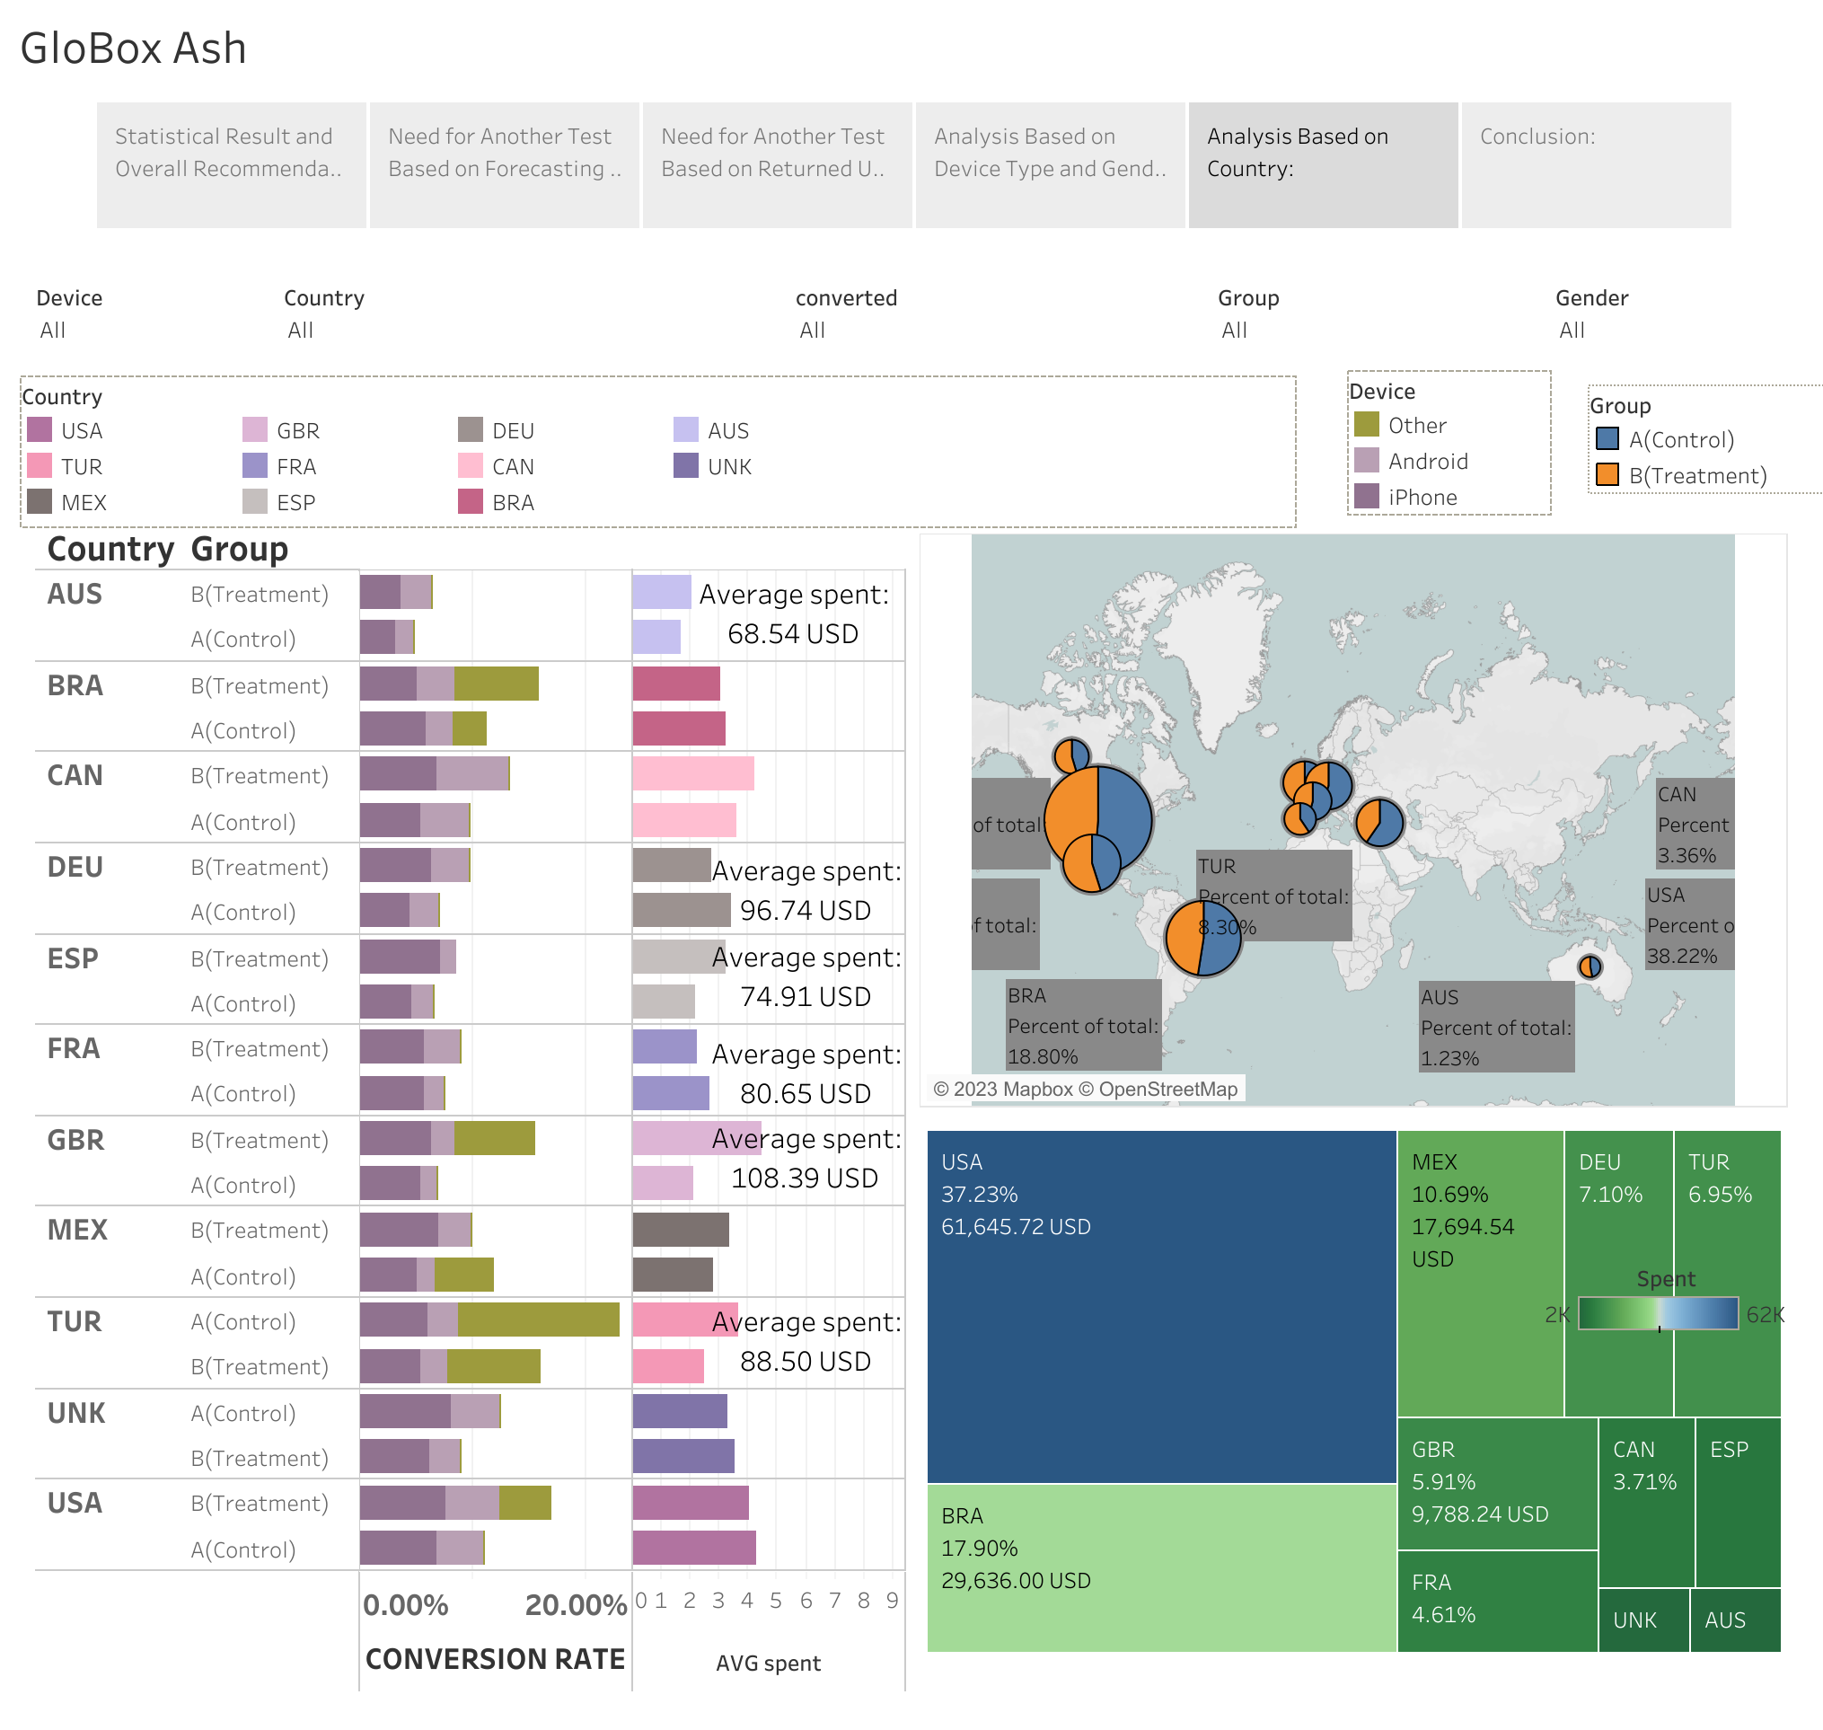
Analysis Based on Country:
• Despite higher user numbers, certain countries (USA, Brazil, France, Turkey, and Germany) exhibited slightly lower average spending.
• Suggestion:
Explore customer preferences in these markets to tailor growth opportunities according to their needs.

Slide 6
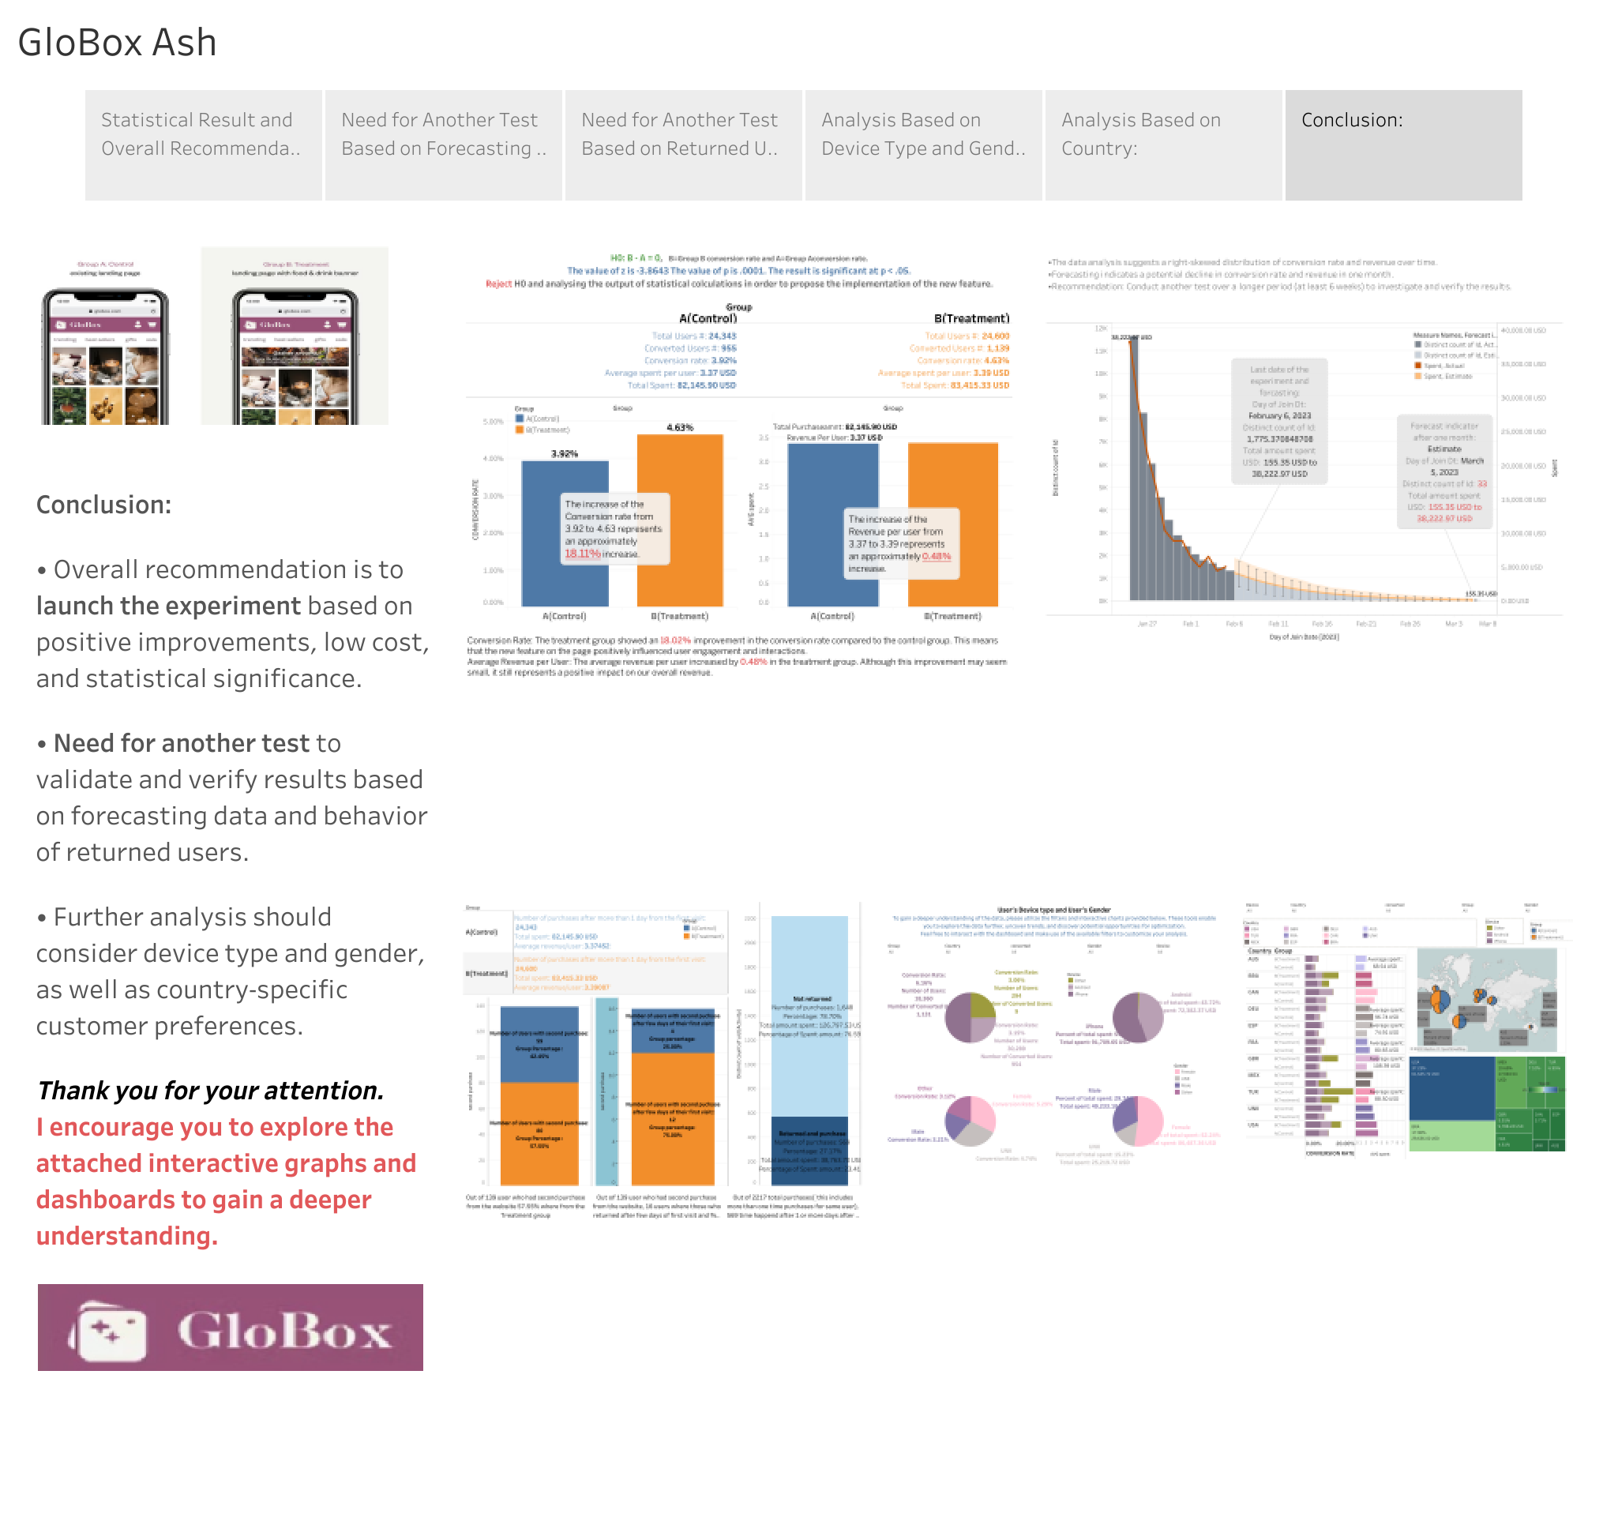
Conclusion:
• Overall recommendation is to launch the experiment based on positive improvements, low cost, and statistical significance.
• Need for another test to validate and verify results based on forecasting data and behavior of returned users.
• Further analysis should consider device type and gender, as well as country-specific customer preferences.
Thank you for your attention.
I encourage you to explore the attached interactive graphs and dashboards to gain a deeper understanding.

